Slide 1
B.TECH CSE · REVIEW I
Intelligent Multi-Pattern Search and Document Analytics Engine
A smart, algorithm-driven system for fast document search, multi-pattern matching and intelligent document analysis.
Team: M RUCHEE · ODDIRAJU SRIDHRUTI · K POOJASRI REDDY | Guide: DR ANITHA PATIL

Slide 2
PROBLEM STATEMENT
The Challenge with Traditional Search
Current Limitations
What We Need
Slow on large documents
One pattern at a time
No document-level insights
Poor scalability
Search multiple patterns simultaneously
Process many documents quickly
Deliver meaningful document analytics
Provide a fast, intelligent, user-friendly search engine

Slide 3
OBJECTIVES
What We Set Out to Build
Fast Search
Document Analytics
Search single and multiple patterns quickly using advanced DSA algorithms.
Analyze uploaded documents for keyword frequency, similarity, and structure.
Algorithm Comparison
User-Friendly UI
Benchmark and compare multiple string-matching algorithms for performance.
Build an intuitive interface for uploading, searching, and viewing results.

Slide 4
TECHNOLOGY STACK
Tools & Technologies
Technology
Purpose
Java
Core programming language
Swing / JavaFX
Desktop user interface
File Handling
Read and parse documents
Data Structures
Efficient data storage
String Matching Algorithms
Fast pattern search
Hashing
Keyword processing
Dynamic Programming
Similarity checking
IDE
Version Control
IntelliJ IDEA
Git & GitHub

Slide 5
Expected Outcomes
Faster search with reduced execution time
Multi-pattern search in a single pass
Rich document analytics and insights
Intuitive, easy-to-use interface
Planned UI Screens
Login & Upload Screen
Search & Analytics Screen
Result Display Screen

Slide 6
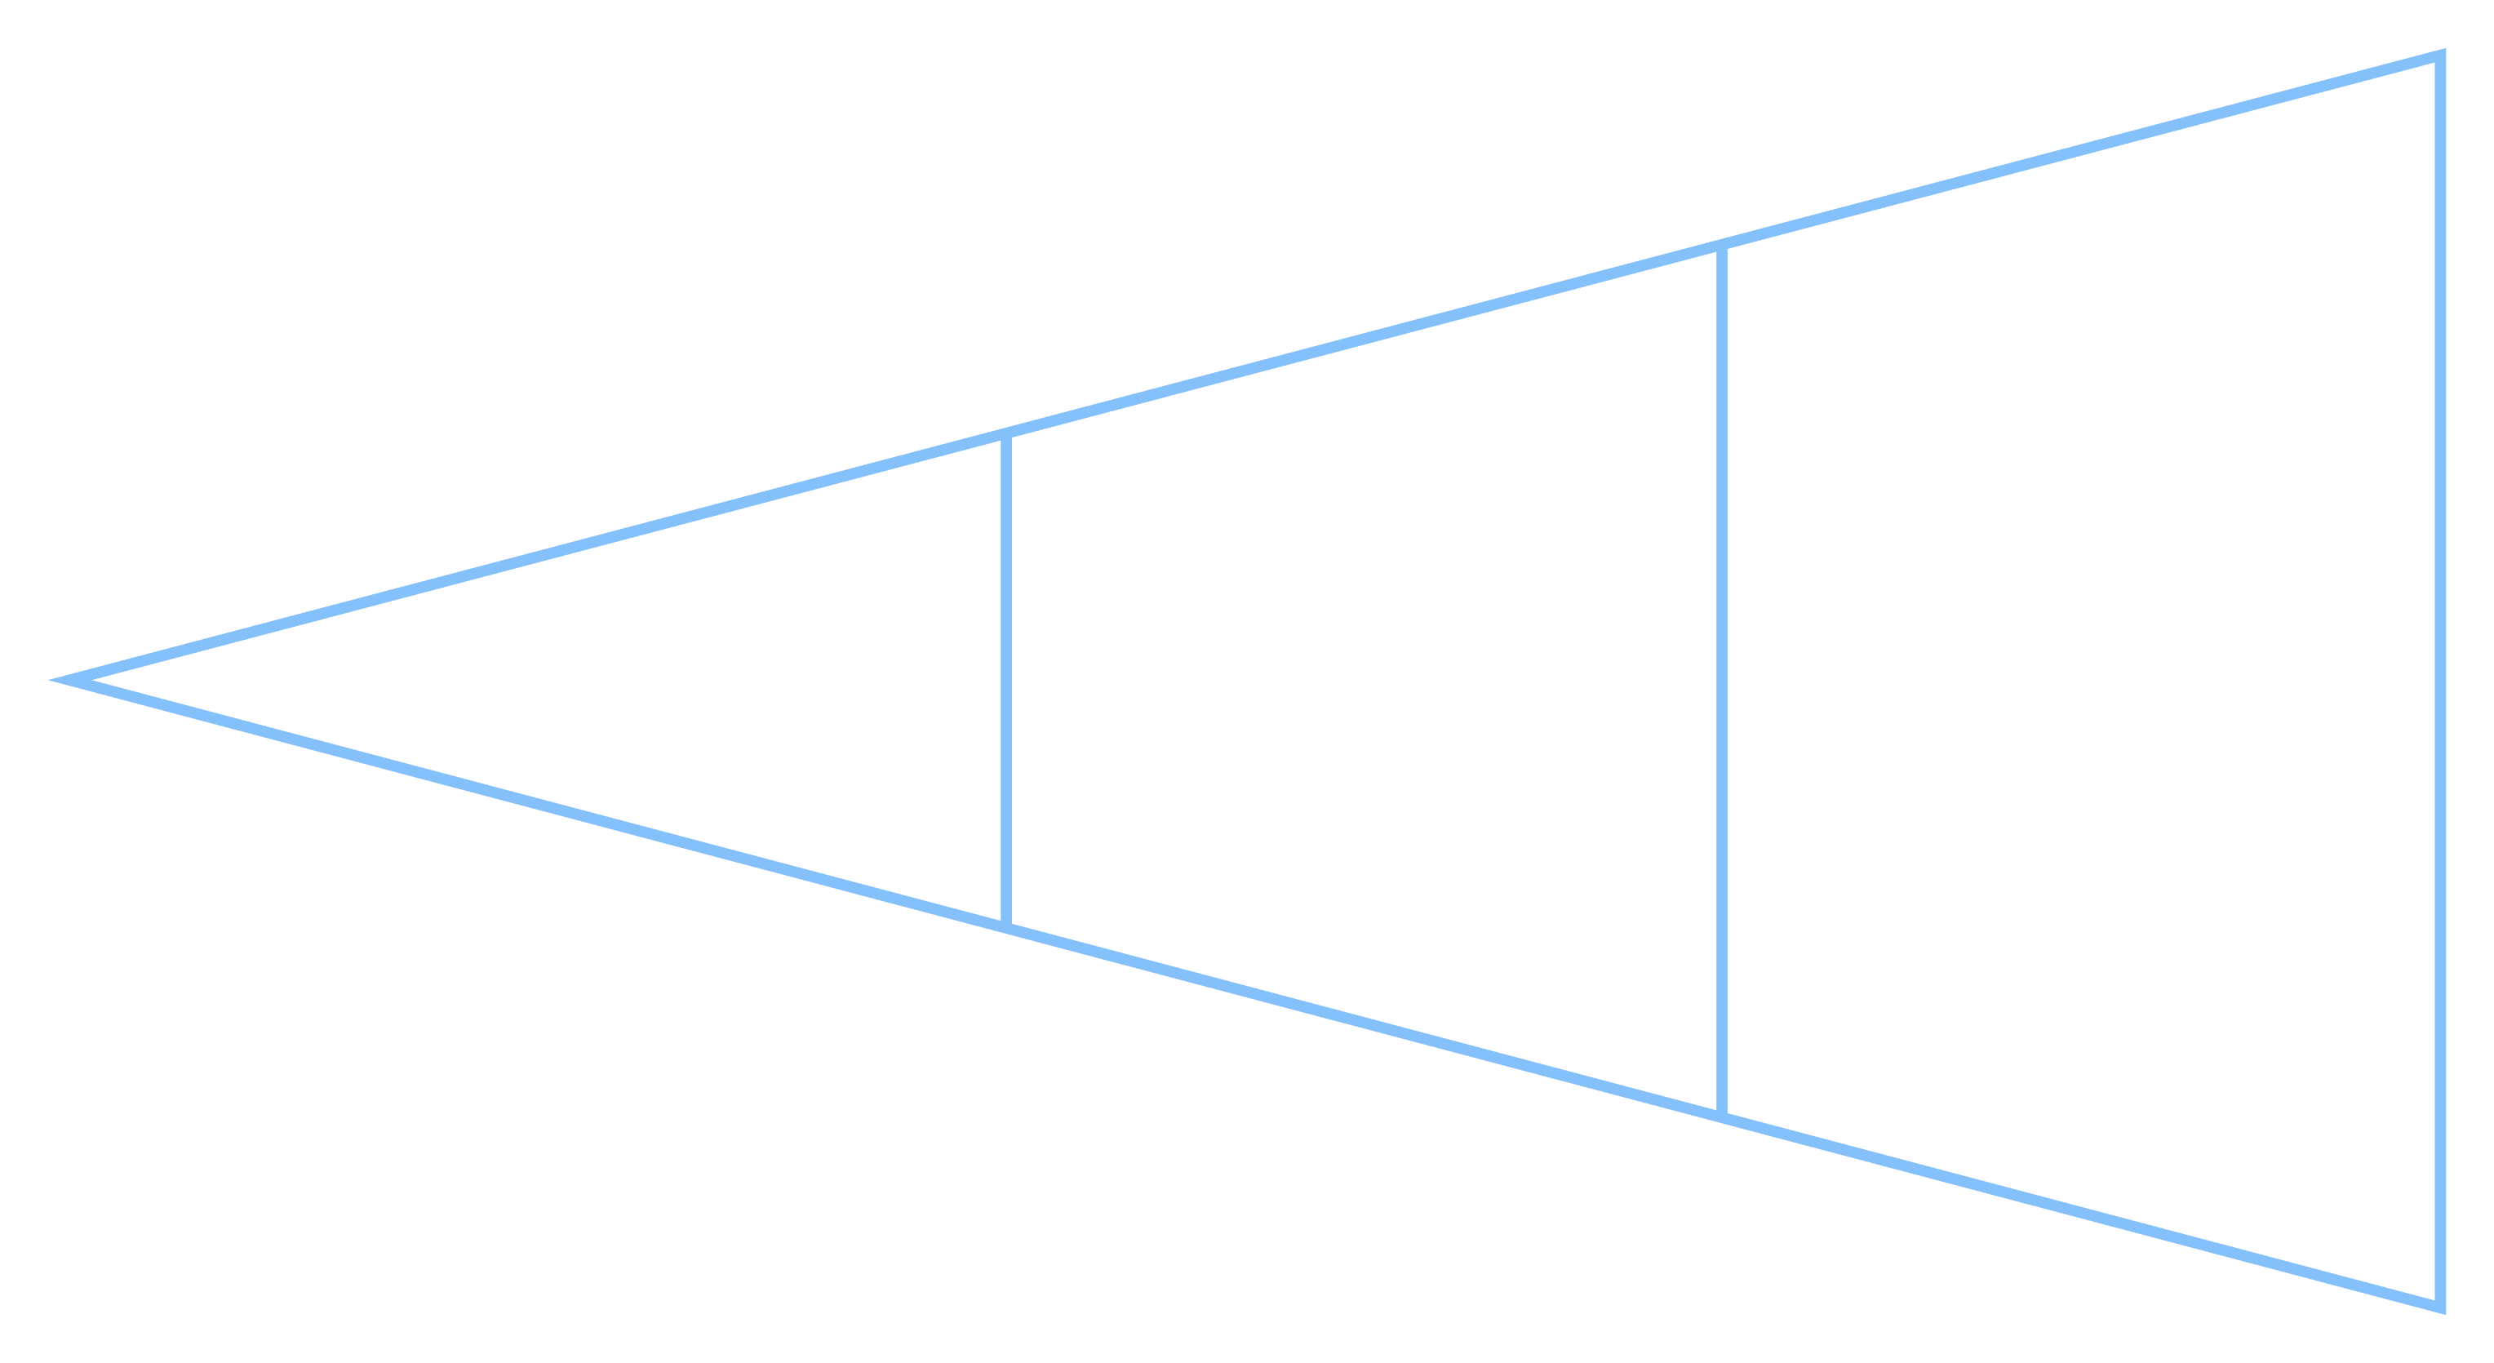







ARCHITECTURE
System Architecture & Modules
User Uploads
Search &
Analytics
Preprocessing
The engine follows a clean four-phase pipeline — from document ingestion through
preprocessing, algorithm-drivensearch and finally analytics and result presentation.
Document Upload
Analytics
Performance Comparison
Preprocessing
Pattern Search
Result Display
Multi-Pattern Matching
Seven tightly integrated modules handle the full lifecycle — from ingestion and preprocessing to search, analytics, and result presentation.

Slide 7
PROGRESS & ROADMAP
Project Timeline
Problem Selection
Requirement Analysis
Algorithm Implementation
Final Review
✅ Completed
✅ Completed
⏳ Pending
🔄 In Progress
1
2
3
4
5
6
7
Literature Survey
UI Design
Testing
✅ Completed
🔄 In Progress
⏳ Pending

